Slide 1

Human development index using ibm Watson studio presented by: (Batch no: 0014) 18uk1a05d6 - jakkoju shruthi 18uk1a0590 - Muzaffar Hussain khan 18uk1a05e6 - kokkirala akshitha 18uk1a05a4 - rudroju sathish

Slide 2
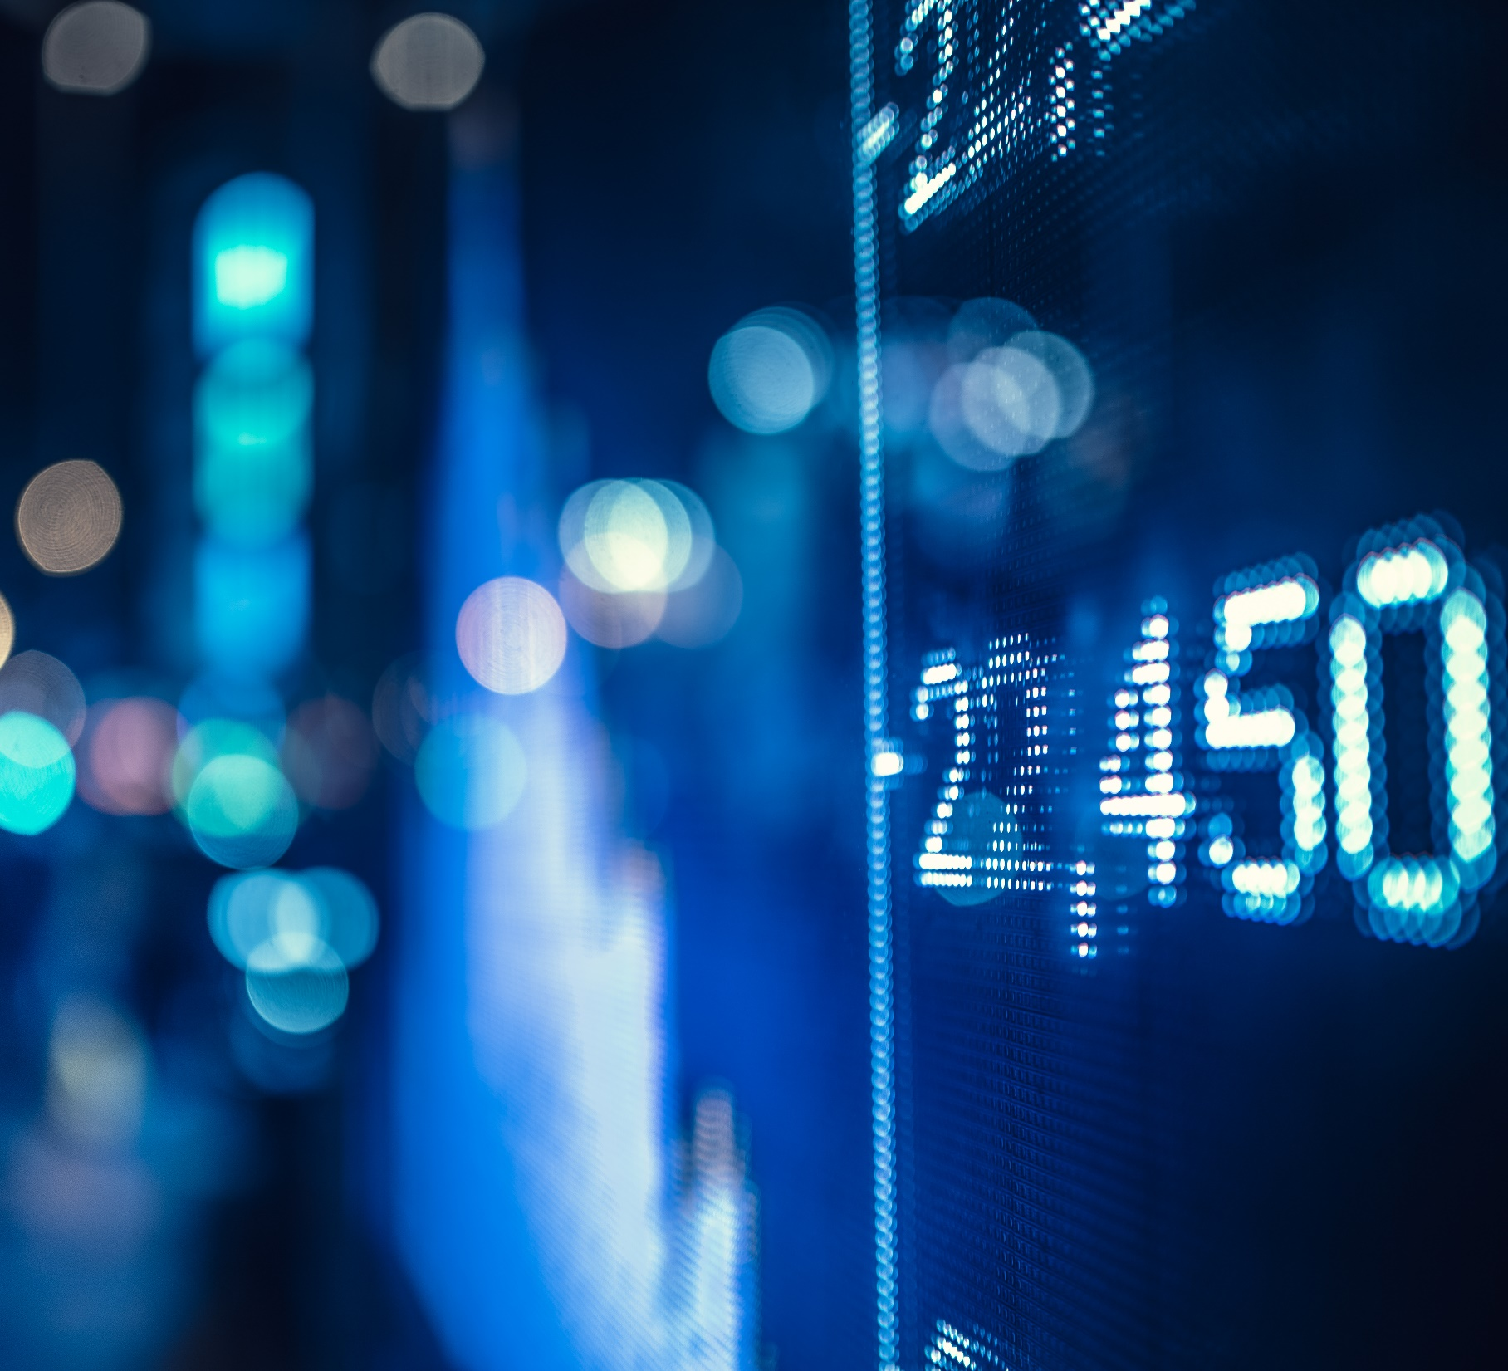
OUTLINE
INTRODUCTION
OBJECTIVE
DATA COLLECTION
DATA PREPROCESSING, VISUALIZATION
ALGORITHMS
MODEL BUILDING
CONCLUSION

Slide 3
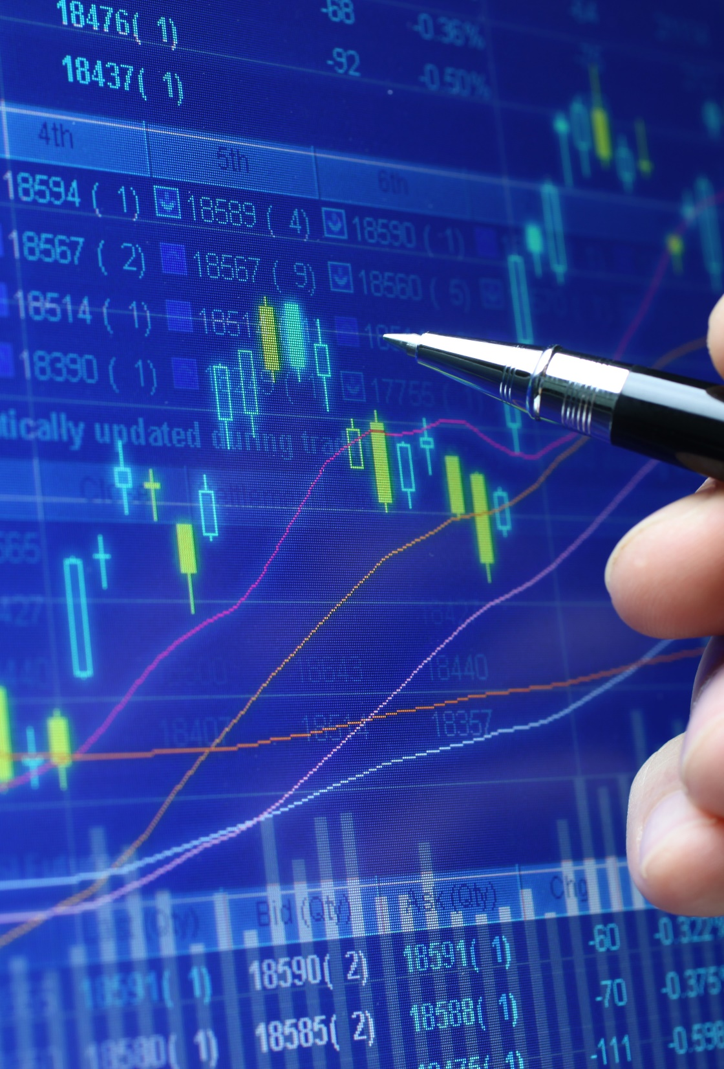
introduction
The Human Development Index (HDI) is a statistical index of life expectancy, education, and per capita income indicators, which are used to rank countries into four tiers (very high, high, medium & low) of human development.
The HDI can be used to question national policy choices, asking how two countries with the same level of GNI per capita can end up with different human development outcomes.
In this project we will be building a machine learning model to predict the Human Development Index of a country by taking a few important aspects as inputs.

Slide 4
objective
The objective of the HDI is to rank countries on a scale of human development conceptualized in terms of capabilities of humans, not economic growth alone.
Prediction of Human Development will help the countries to analyze and identify dependent variables and do required steps to develop their countries and get the higher rank.

Slide 5
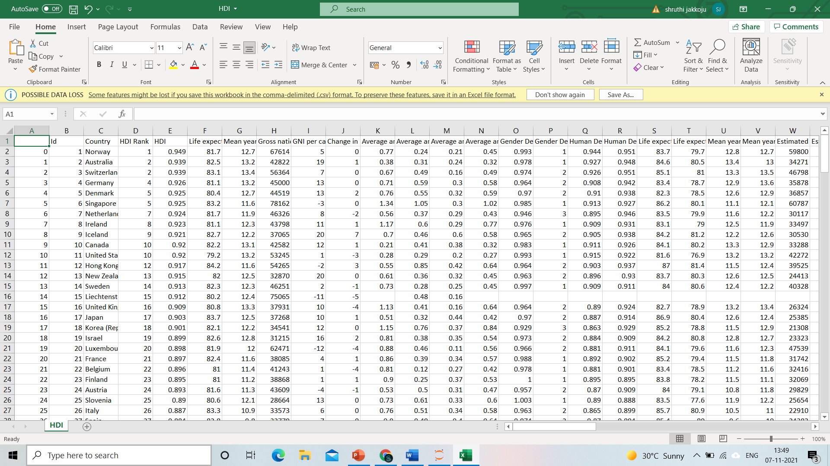
DATA
Dataset contained of 195 rows and 82 columns.
Selected dataset attributes are:
Country
HDI rank
Life expectancy
Mean years of schooling
Gross national income(GNI) per capita
Internet users.

Slide 6
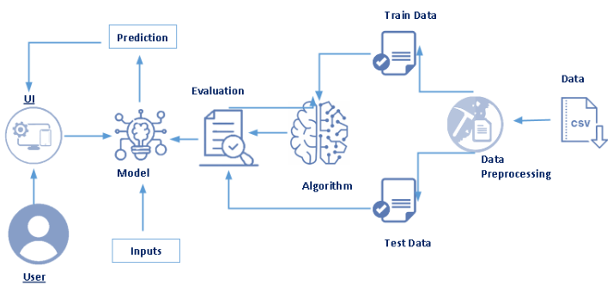
Technical architecture

Slide 7
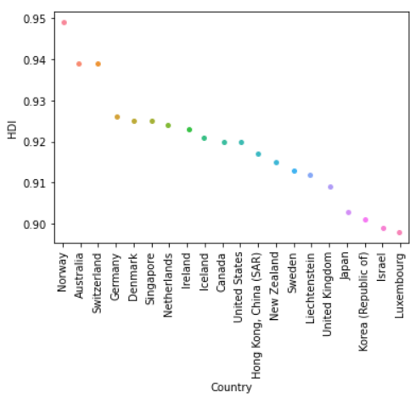
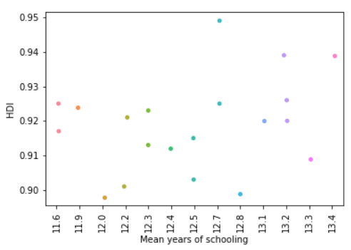
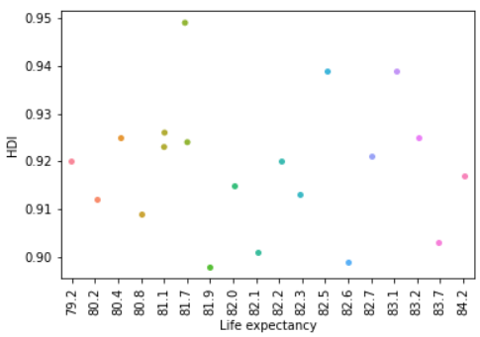
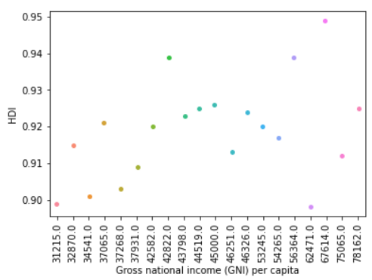
DATA EXPLORATION
HDI vs Country | HDI vs Mean years of schooling
HDI vs Life expectancy | HDI vs GNI per capita

Slide 8
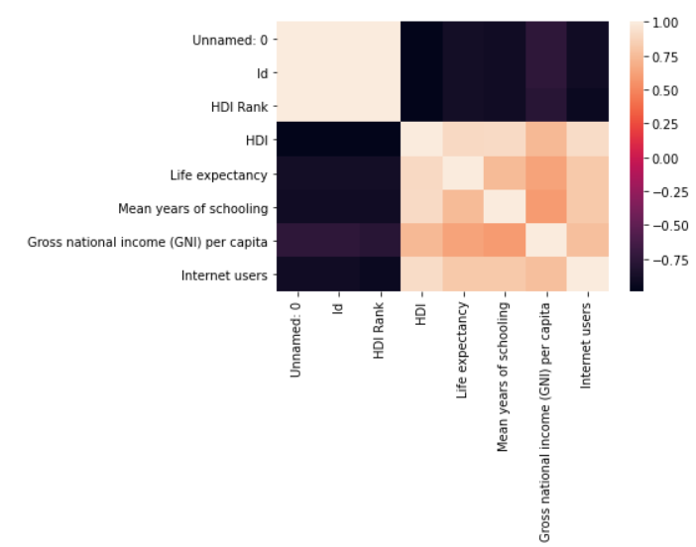
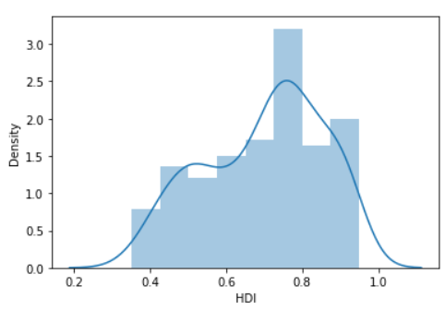
DATa visualization
We considered few attributes among 82 by visualizing the data and building the correlation matrix which is used to summarize the data and demonstrate the linear relationship between the attributes.

Slide 9
Algorithm
Linear regression :
Linear Regression is a machine learning algorithm based on supervised learning. It performs a regression task. Regression models a target prediction value based on independent variables. It is mostly used for finding out the relationship between variables and forecasting.
Why linear regression?
In this problem the HDI is based on the four main dimensions. Therefore Human development index will depend on Life expectancy, Mean years of schooling, Gross National Income (GNI) per Capita, Internet users. Increasing and decreasing of mentioned four dimensions are continuously cause for the value of the Human Development Index. Therefore we have to use Linear Regression algorithm to go through this.

Slide 10
Data preprocessing encoding the categorical data
Since this is a linear regression model, there can be only numerical data as variables. But in the dataset there is a categorical variable ‘Country’. So, values in this variable has to be encoded to use in a linear regression model. LabelEncoder() and Mapping methods are used to do this task. Country column’s data passed into these methods to encode these data and each unique country is mapped to unique numeric values.

Slide 11
MODEL BUILDING
By using Linear Regression Algorithm we are fitting our model in order to obtain the prediction. Then we predict the model. In this 70% of the data is used for training and 30% of the data for testing. Training dataset is used to train the machine learning model and test dataset is used to test and evaluate the accuracy of trained model. X_train and y_train parameters are passed into this model with the help of fit() method. After we calculated the r squared value to determine how well the model had fit the data and we got the more accurate value 0.95. So lastly we dumped the model into a pickle file and saved our model.

Slide 12

Building flask web application
Here after saving our model we create a flask web application which is a process of importing the required libraries , routing to html pages using different constructors and methods. A main function is used to run the application on a localhost where we predict the results.

Slide 13
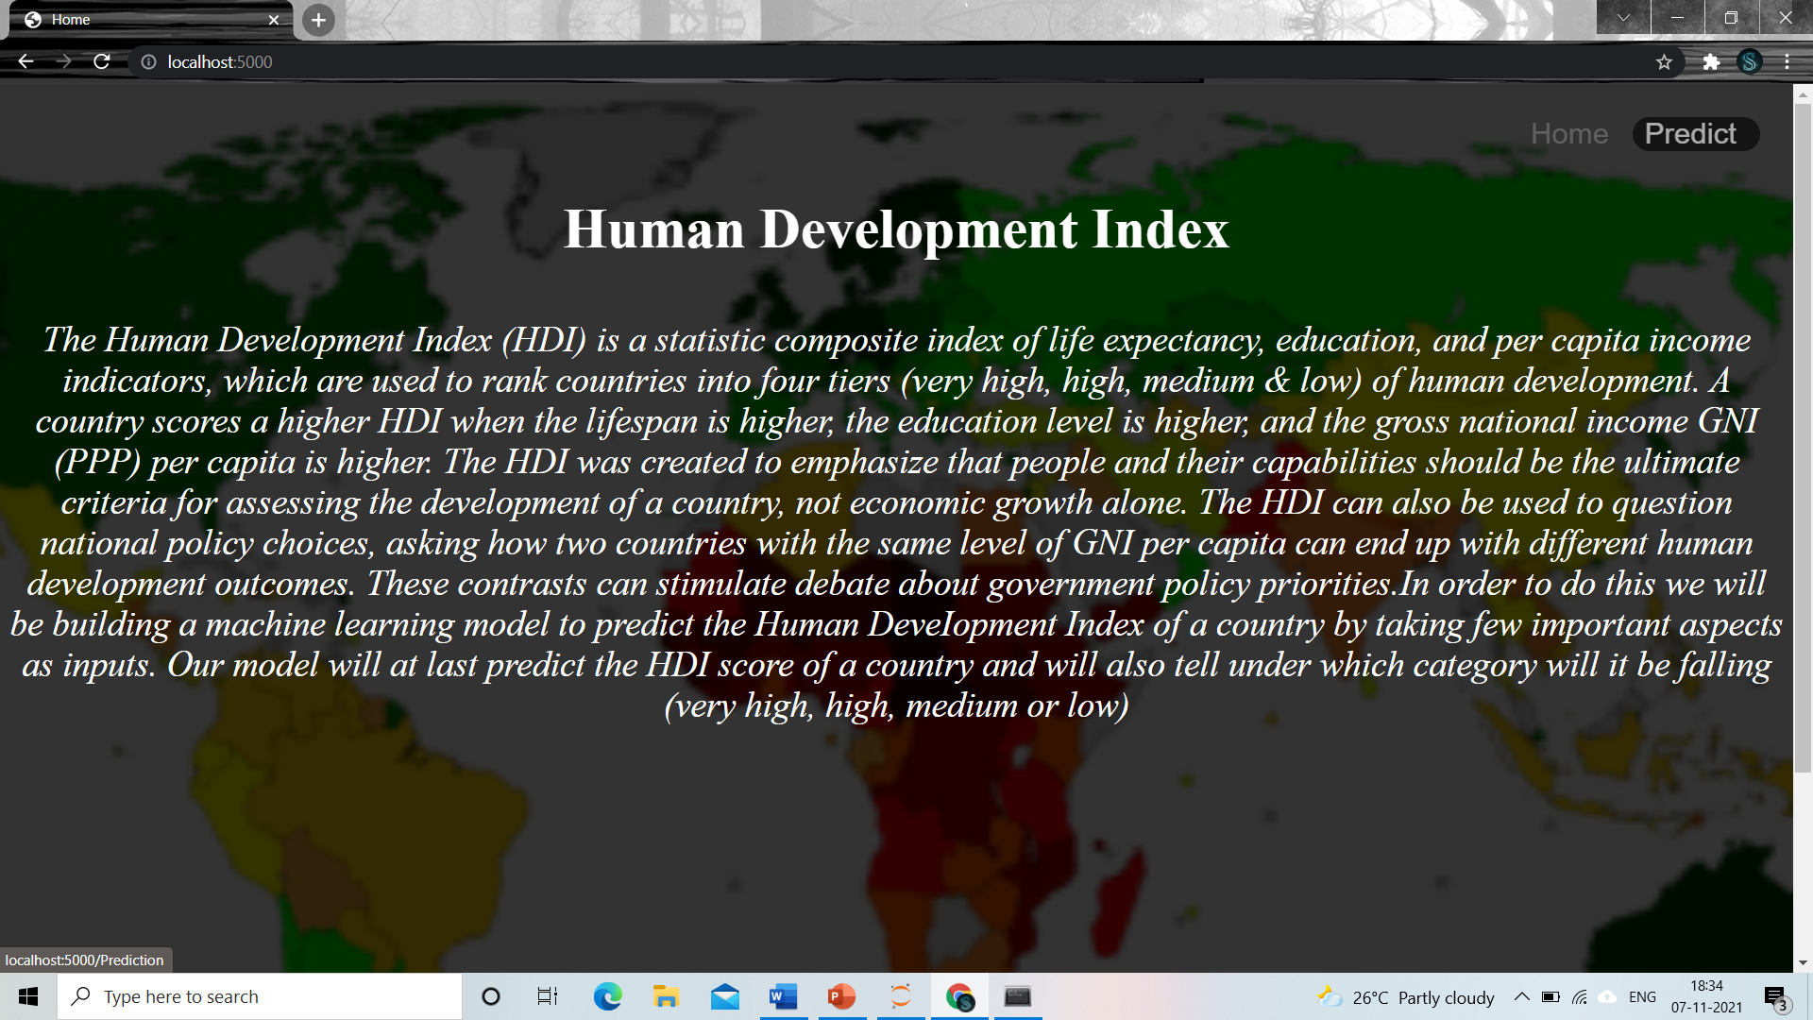
Predicting the results
This is the home page where a brief introduction is given about the Human Development Index and its importance. To see the prediction you need to click on predict on the top right corner. You will be navigated to the prediction page .

Slide 14
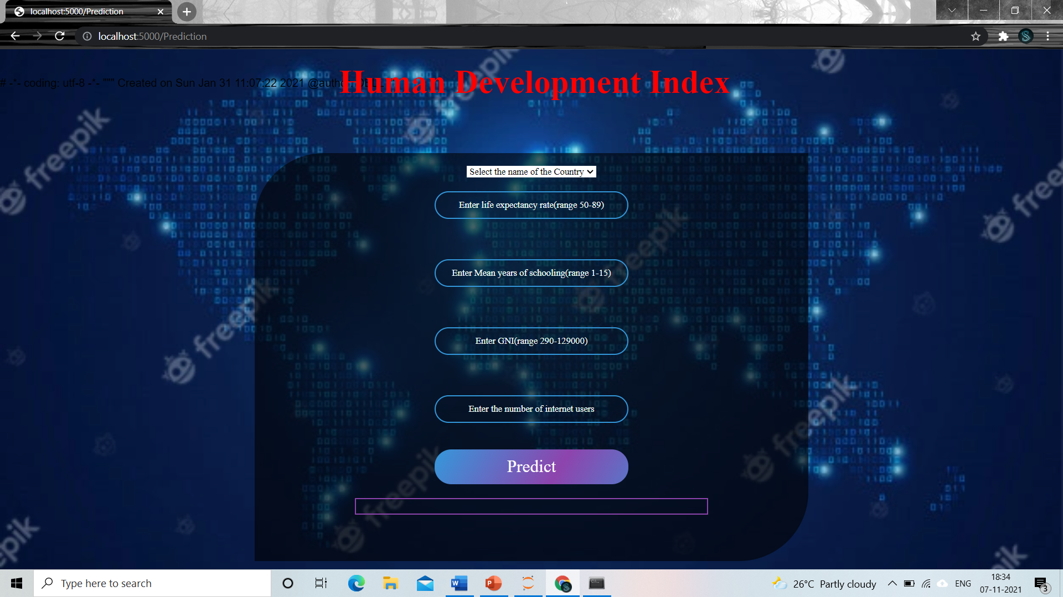
Predicting the results
Here in the prediction page we get to choose the country for which we want to predict the HDI score, enter the values in the required areas in the mentioned ranges. Then click on predict to see the predicted result.

Slide 15
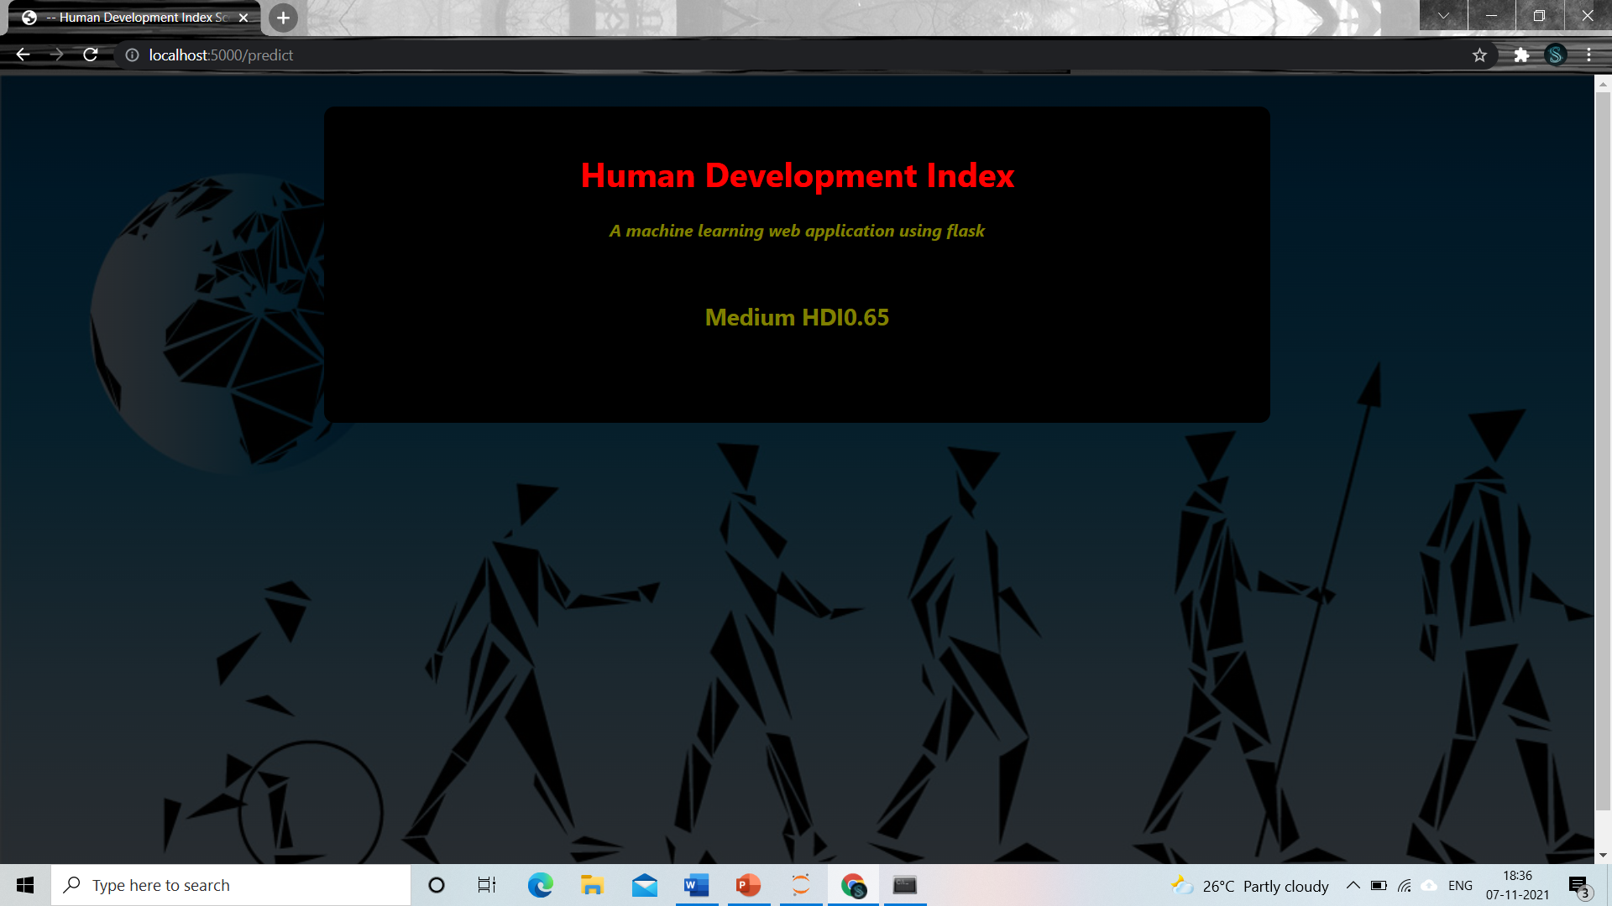
Final output
We see that the prediction of the model is High. The country has a Medium HDI score. In the same way we can try different countries.

Slide 16
Deploying the model on ibm
Finally we deploy our machine learning model on IBM by firstly training the model by using IBM services namely
Machine learning service
Watson studio service

Slide 17
conclusion
In conclusion, we proposed a machine learning model to predict the Human Development Index of the country using the machine learning tools. This system can be used to predict the index of human development of a country and also know into which category it falls into like low, very low, medium, high and very high. For better results we used linear regression algorithm and proved with 95% accuracy.

Slide 18
Thank you

